Slide 1
Traffic Signal
Traffic signals are control devices which could alternately direct the traffic to stop and proceed at intersections using red and green traffic light signals automatically.
These are provided at intersections where the traffic volume is considerably high.
Conflicts at the intersections gain more significance as the traffic volume increases.
The main requirements of traffic signal are:
(a) To draw attention,
(b) To provide sufficient time to respond
(c) with the minimum waste of time.

Slide 2
Traffic Signal - Advantages
They provide orderly movement of traffic and increase the traffic handling capacity at intersections.
They reduce the accidents.
Pedestrians can cross the roads safely at the signalised intersections.
They provide all the vehicles to move approximately at same reasonable speed along the major road traffic.
Traffic handling capacity is highest among different types of intersections at grade.
Automatic traffic signal may work out to be economical compared to manual control.
When signal system is properly coordinated there is a reasonable speed increase along the major road traffic.
Provide a chance to traffic of minor road to cross the continuous traffic flow of the main road at reasonable intervals of time.

Slide 3
Traffic Signals – Disadvantages
The rear-end collisions may increase.
Improper design and location of signals may lead to violations of the control system.
Failure of the signal due to electric power or any other defect may cause confusion to the road users.
Variation of vehicles on approach roads may increase in waiting time on one road and unused green time on the other road, when fixed traffic signals are used.

Slide 4
Warrants for installation of traffic control signal
Traffic signals should not be installed unless one or more of the following conditions are met:
Minimum vehicular volume:
Avg traffic volume for 8hrs of the day should be 650 vehicles per hour on major streets with single lane and 800 vehicles per hour on streets with two or more lanes.
If the 85th percentile speed on major ROADS exceeds 60 kmph or the intersection lies within built up area, the vehicle volume warrant may be decreased to 70% of above requirement.

Slide 5
Warrants for installation of traffic control signal
Interruption of continuous traffic flow:
When the traffic flow on major street is 1000 to 1200 vehicles per hour and there is undue delay or hazard to traffic on minor road with traffic of 100 to 150 vehicles per hour in one direction only during any 8 hours of an average day.

Slide 6
Warrants for installation of traffic control signal
3. Minimum Pedestrian Volume: When 150 or more pedestrians per hour cross a major street with over 600 vehicles per hour on both approaches. However when the average approach speed or 85th percentile speed exceeds 60 kmph, 70% of the above requirement may be adopted.
4. Accident experience: If accident record shows that the other measures have failed to decrease the accident frequency or when 5 or more accidents have occurred in the last one year.
5. Combination of all above Warrants.

Slide 7
Definitions and Notations
Signal Cycle:
The period of time required for one complete sequence of signal indication is called signal cycle. The cycle length /duration is indicated by ‘C’.
2. Interval:
It indicates the change from one stage to another. There are two types of intervals - change interval and clearance interval.
Change interval is also called the yellow time indicates the interval between the green and red signal indications for an approach.
Clearance interval is also called all red and is provided after each yellow interval indicating a period during which all signal faces show red and is used for clearing off the vehicles in the intersection.

Slide 8
Definitions and Notations
3. Green interval:
It is the green indication for a particular movement or set of movements and is denoted by ‘G’.
This is the actual duration the green light of a traffic signal is turned on.
4. Red interval:
It is the red indication for a particular movement or set of movements and is denoted by ‘R’.
This is the actual duration the red light of a traffic signal is turned on.

Slide 9
Definitions and Notations
5. Phase:
A phase is the green interval/red interval plus the change and clearance intervals that follow it.
Thus, during green interval, non conflicting movements are assigned into each phase.
It allows a set of movements to flow and safely halt the flow before the phase of another set of movements start.

Slide 10
Definitions and Notations
6. Lost time:
It indicates the time during which the intersection is not effectively utilized for any movement.
For eg, when the signal for an approach turns from red to green, the driver of the vehicle which is in the front of the queue, will take some time to perceive the signal (reaction time) and some time will be lost before vehicle actually moves and gains speed.

Slide 11
Types of Traffic signals
Traffic Control Signals
Pedestrian Operated Signals
Specific Traffic Signals

Slide 12
Traffic Control Signals
The traffic control signals have three coloured light glows facing each direction of traffic flow.
The red light is meant for ‘stop’,
The green light indicates ‘go’ and
The amber or yellow light allows the ‘clearance time’.

Slide 13
Traffic Control Signals
a) Fixed-time signals: are those in which the timings of the phase & cycle are set to repeat regularly; a cycle of red, amber & green lights.
b) Manually operated signals: are those which are operated manually.
c) Traffic actuated (automatic) signals: are those in which the timing of the phase & cycle are changed automatically according to traffic demand.

Slide 14
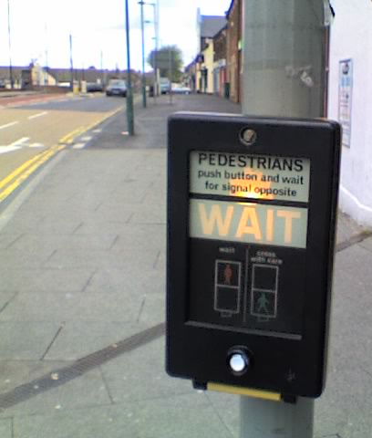
ii) Pedestrian Operated Signals:
These signals are meant to give right of way to pedestrians to cross a road during walk period when vehicular traffic shall be stopped by red.
iii) Specific Traffic Signals:
Special traffic signals such as flashing beacons may be installed at certain locations in order to warn the traffic of certain situations. At flashing red signals, the driver of a vehicle shall stop before entering the intersection.
Flashing yellow signals are cautionary signals meant to signify that the drivers may proceed with caution.

Slide 15
Phase Design
The objective of phase design is to separate the conflicting movements in an intersection into various phases, so that movements in a phase should have no conflicts.
If all the movements are to be separated with no conflicts, then a large number of phases are required.
In such a situation, the objective is to design phases with minimum conflicts or with less severe conflicts.
There is no precise methodology for the design of phases. This is often guided by the geometry of the intersection, the flow pattern especially the turning movements, & the relative magnitudes of flow.
Therefore, a trial and error procedure is often adopted.
However, phase design is very important because it affects the further design steps.
Further, it is easier to change the cycle time and green time when flow pattern changes, where as a drastic change in the flow pattern may cause considerable confusion to the drivers.

Slide 16
Phase Design
The signal design procedure involves six major steps. They include:
phase design,
determination of amber time and clearance time,
determination of cycle length,
apportioning of green time,
pedestrian crossing requirements, and
performance evaluation of the design obtained in the previous steps.

Slide 17
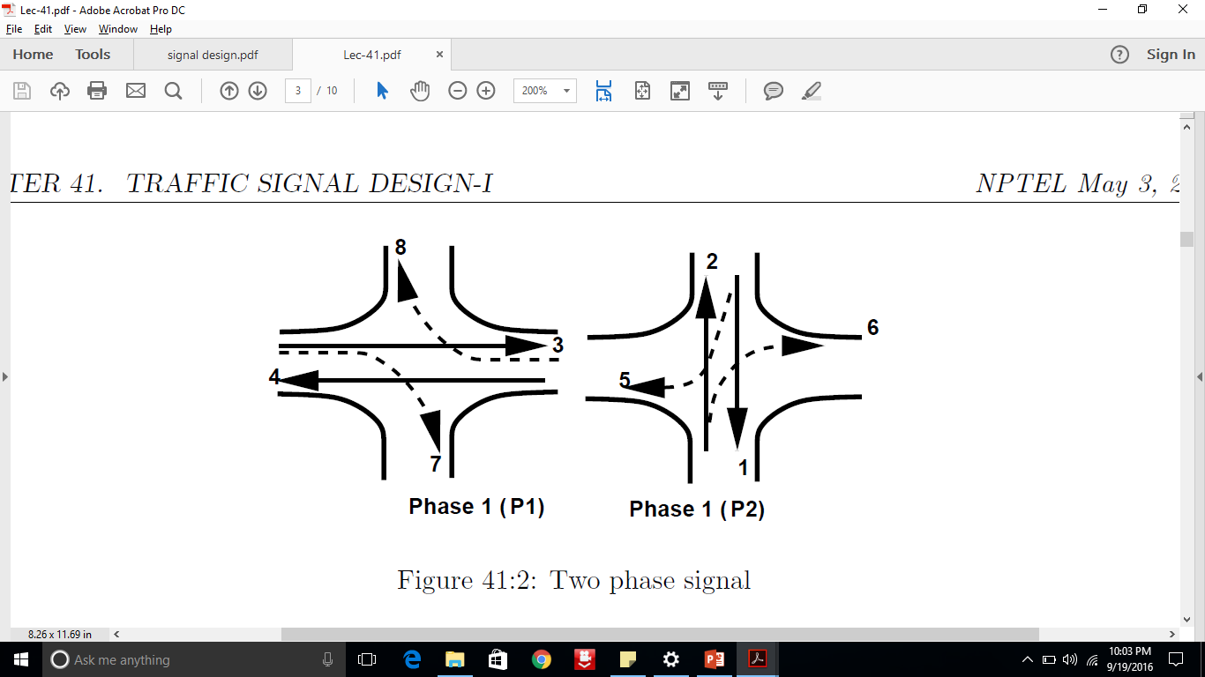

Two Phase Signals
Two phase system is usually adopted if through traffic is significant compared to the turning movements.
For ex in the fig, non-conflicting through traffic 3 & 4 are grouped in a single phase & non-conflicting through traffic 1 & 2 are grouped in the second phase.
However, in the first phase flow 7 & 8 offer some conflicts & are called permitted right turns.
Needless to say that such phasing is possible only if the turning movements are relatively low.
On the other hand, if the turning movements are significant ,then a four phase system is usually adopted.

Slide 18
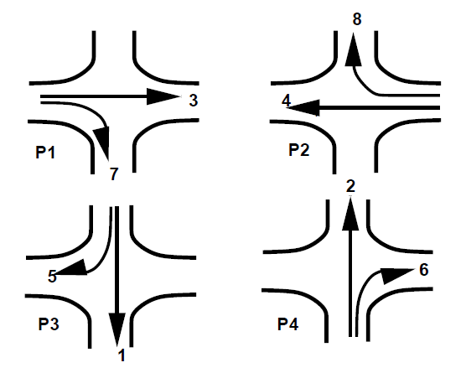
Four phase signals
There are at least three possible phasing options.
For ex, fig shows the most simple phase plan where, flow from each approach is put into a single phase avoiding all conflicts.
This type of phase plan is ideally suited in urban areas where the turning movements are comparable with through movements and when through traffic and turning traffic need to share same lane.
This phase plan could be very inefficient when turning movements are relatively low.

Slide 19
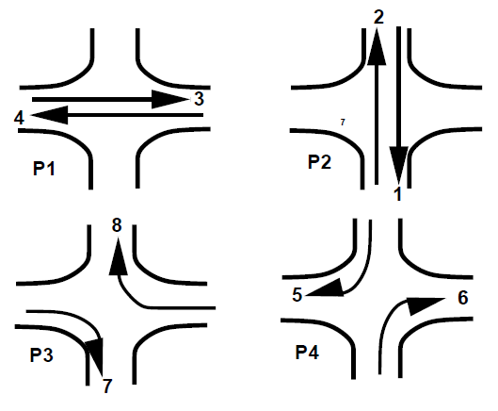
Four phase signals
Fig shows a second possible phase plan option where opposing through traffic are put into same phase.
The non-conflicting right turn flows 7 and 8 are grouped into a third phase. Similarly flows 5 and 6 are grouped into fourth phase.
This type of phasing is very efficient when the intersection geometry permits to have at least one lane for each movement, and the through traffic volume is significantly high.

Slide 20
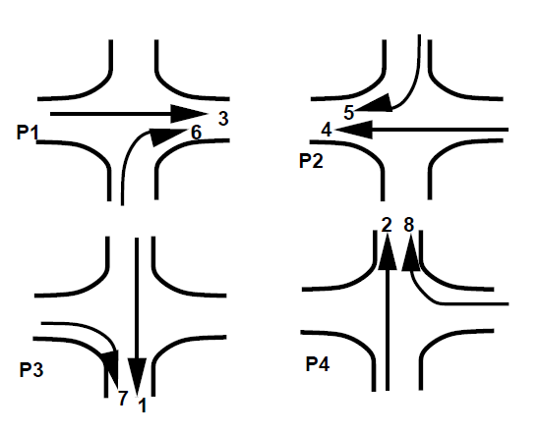
Four phase signals 3rd Way of Providing 4 phase traffic signal

Slide 21
General Principles of two-phase signal design
Let the two approach roads, designated as Road-1 and Road-2 have green, red and amber phases designated as G1, R1, A1, and G2, R2, and A2 respectively.
Stop time or red phase, R1 for road-1 of a signal is the sum of green phase and clearance intervals or amber phases for the cross flow i.e., R1 = (G2+A2) at a two phase signal. During this interval, the pedestrian crossing time may also be incorporated for the road, if turning movements are not permitted.

Slide 22
General Principles of two-phase signal design
Towards the end of red phase, there may be a short duration when the amber lights are put on along with red light signal in order to indicate ‘get set’ to go. This phase is the last part of red phase itself and may be called ‘red-amber’ or ‘initial amber’. The vehicles are not supposed to cross the stop line during the red-amber period.

Slide 23
General Principles of two-phase signal design
iii) Clearance time or clearance-amber phase is provided just after the green phase before the red phase, to fulfil the two requirements:
To allow stopping time for approaching vehicle to stop at stop-line after the signal changes from green to amber and not to cross the line by the time the signal changes to red phase.
To allow clearance time for the vehicle which is approaching the stop line at legal speed while the signal changes from green to amber, allowing sufficient time for the vehicle to cross the intersection as it may not be possible for the vehicle to stop before the stop line at that stage. Usually 2.0 to 4.0 seconds would be suitable for the amber phase so as to fulfil these two conditions.
iv) Go time or green time is decided based on the approach volume during peak hour and to enable the queued vehicles to clear off in most of the cycles.

Slide 24
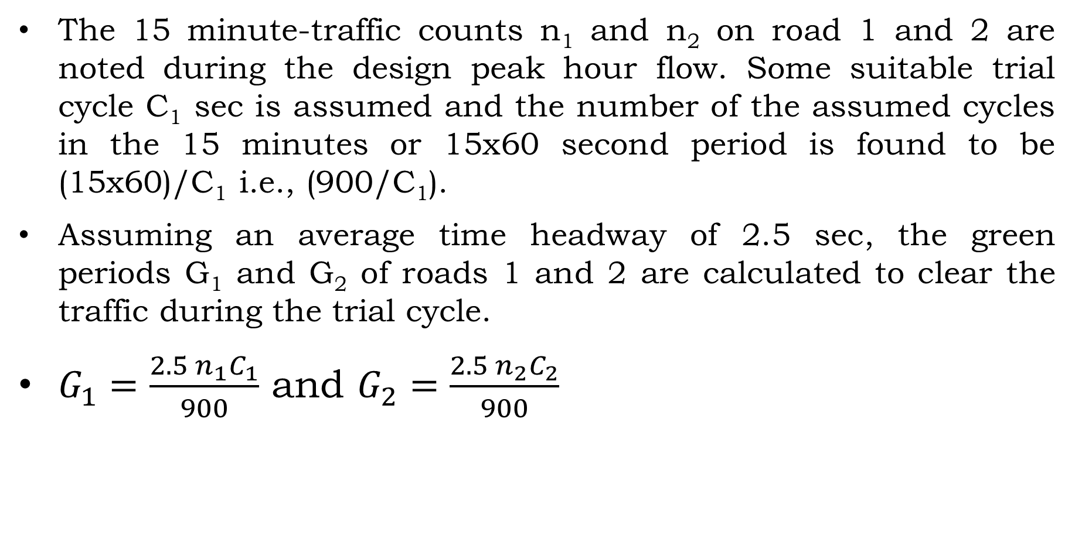
Trial cycle method of signal design
The 15 minute-traffic counts n₁ and n₂ on road 1 and 2 are noted during the design peak hour flow. Some suitable trial cycle C₁ sec is assumed and the number of the assumed cycles in the 15 minutes or 15x60 second period is found to be (15x60)/C₁ i.e., (900/C₁).
Assuming an average time headway of 2.5 sec, the green periods G₁ and G₂ of roads 1 and 2 are calculated to clear the traffic during the trial cycle.
$G_{1}=\frac{2.5 n_{1}C_{1}}{900}$ and $G_{2}=\frac{2.5 n_{2}C_{2}}{900}$

Slide 25
Trial cycle method of signal design
The amber periods A1 and A2 are either calculated or assumed suitably (3 to 4 seconds) and the trial cycle length, is calculated,
C1’=(G1 + G2 + A1 + A2)sec.
If the calculated cycle length C₁’ works out to be equal to the assumed cycle length C₁, the cycle length is accepted as the design cycle. Otherwise the trials are repeated till the trial cycle length works out equal to the calculated value.

Slide 26
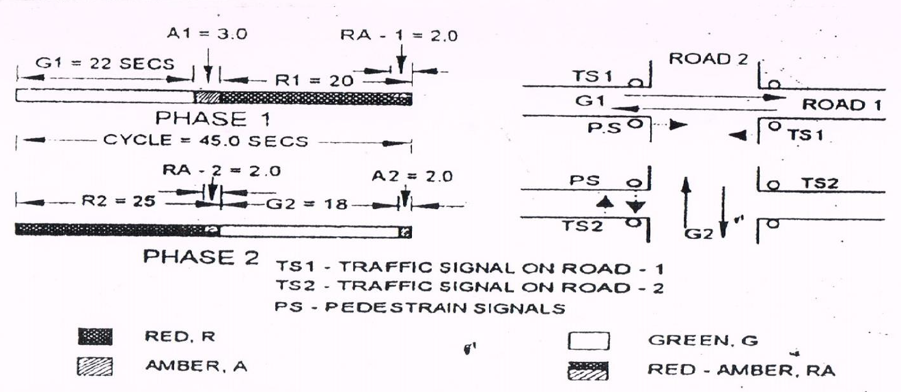
Trial cycle method of signal design

Slide 27
Trial cycle method of signal design

Slide 28
Signal design based on pedestrian crossing requirement
Approximate design of a two phase traffic signal unit at cross roads, along with pedestrian signals:
Based on pedestrian walking speed of 1.2m per sec & the roadway width of each approach road, the minimum time for the pedestrian to cross each road is also calculated
Total pedestrian crossing time is taken as minimum pedestrian crossing time plus initial interval for pedestrians to start crossing, which should not be less than 7 sec and during this period when the pedestrians will be crossing the road, the traffic signal shall indicate red or ‘stop’.

Slide 29
Signal design based on pedestrian crossing requirement
c) The red signal time is also equal to the minimum green time plus amber time for the traffic of the cross road.
d) The actual green time needed for the road with higher traffic is then increased in proportion to the ration of approach volumes of the two roads in vehicles per hour per lane
e) Based on approach speeds of the vehicles, the suitable clearance interval between green and red period i.e., clearance amber periods are selected. The amber periods may be taken as 2, 3 or 4 seconds for low, medium and fast approach speeds.

Slide 30
Signal design based on pedestrian crossing requirement
f) The cycle length so obtained is adjusted for the next higher 5-sec interval; the extra time is then distributed to green timings in proportion to the traffic volumes
g) The timings so obtained are installed in the controller and the operations are then observed at the site during peak traffic hours; modifications in signal timings are carried out if needed.

